Slide 1
Console Based Bank Management Application Using JAVA List
PRESENTED BY :-
SARATH KUMAR R

Slide 2
INTRODUCTION
The Bank Account Management System is an console based application for maintaining a individual Customer account in a Certain Bank. That application contain some basic functionality of a Banking Management System . This project has been developed to carry out the processes easily and quickly , which is not possible with the manual system , which are overcome by this application. The system is designed as an interactive and content management system. User will have all options and features in that application like Deposit, withdraw, money transfer to others and some more baking service like beneficiary addition as well simply adding them as payees.
.

Slide 3
PROBLEM STATEMENT
The main reason behind developing this project is the problems which were faced by the account holders. Employees of the bank because of shortage of time and convenience. Banks are usually only open Monday through Friday from 9 am to 5 pm. These hours may be convenient for the bank tellers and workers but with a normal full time job, these hours are difficult for the customers of the Bank. It was difficult for the bank to handle the several customers and their account management.

Slide 4
FEATURES
User Account details.
Deposit Money
Withdraw money
Beneficiary Addition
Fetch Beneficiary Account details.
Money Transfer
View Account Balance.

Slide 5
BENEFITS
Convenience: Unlike your corner bank, online banking sites never close; they’re available 24 hours a day, seven days a week, and they’re only a mouse click away.
Accessibility: If you’re out of state or even out of the country when a money problem arises, you can log on instantly to online bank and take care of business, 24/7.
Efficiency: You can access and manage all of your bank accounts from secure site.
Transaction speed: Online bank sites generally execute and confirm transactions at or quicker than ATM processing speeds.

Slide 6
SYSTEM REQUREMENTS
Software Requirements :
Operating System - Windows
Programming Language - Core Java
IDE - Eclipse J2EE
Hardware Requirements :
Processor - Intel i3 and above
Ram - 128 MB
 Hard Disk - 50 GB

Slide 7
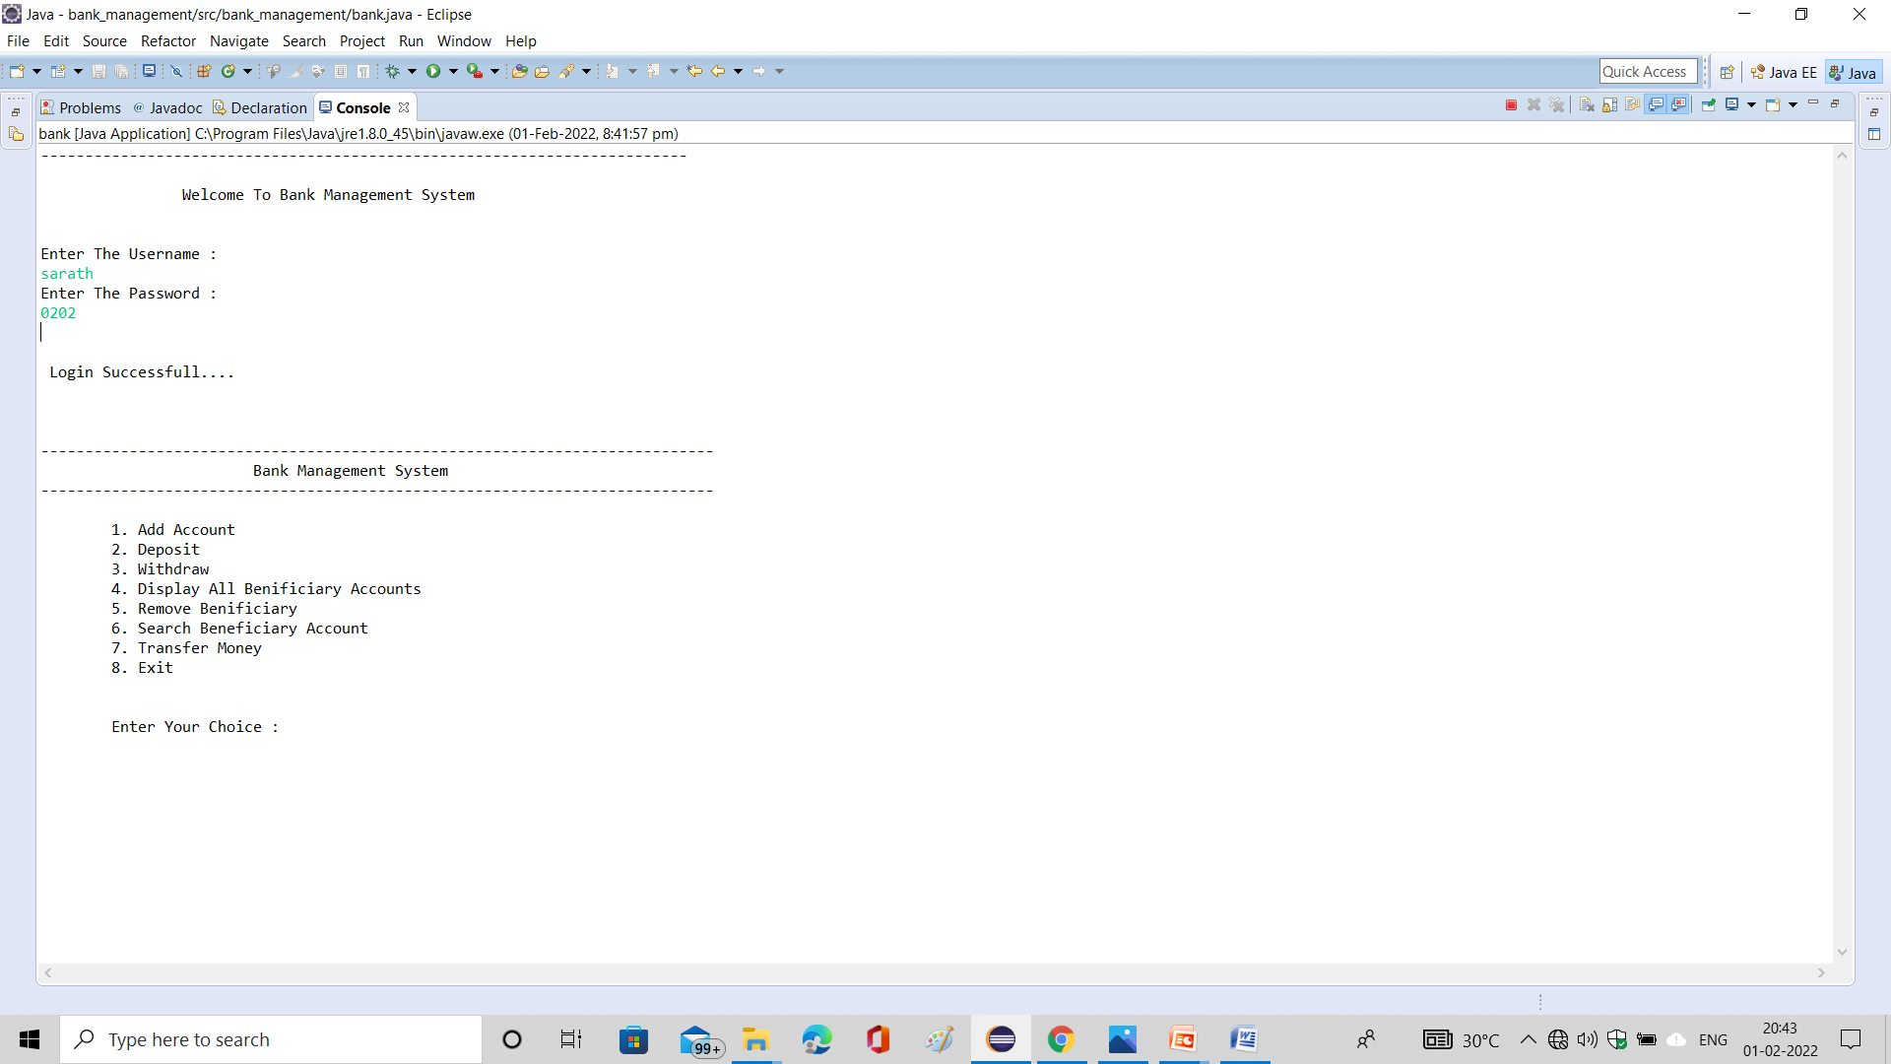
PROJECT OUTPUT

Slide 8
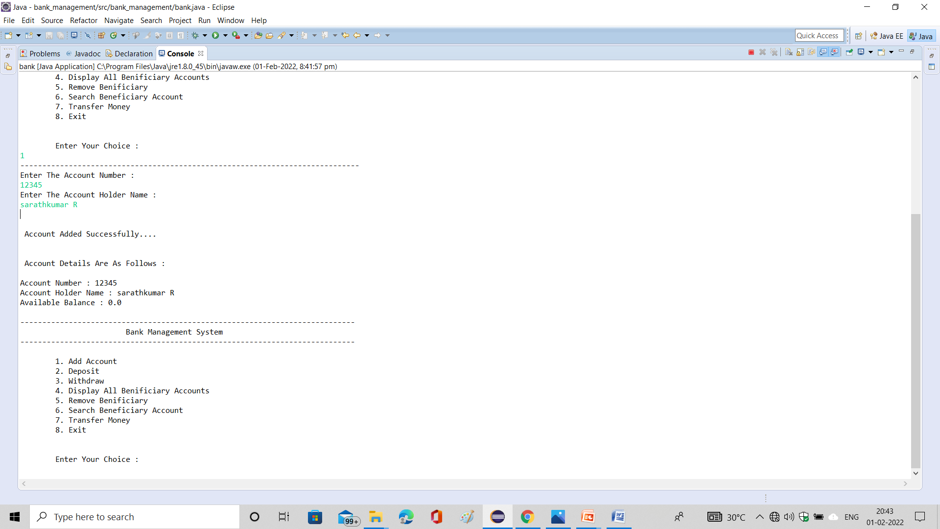

Slide 9
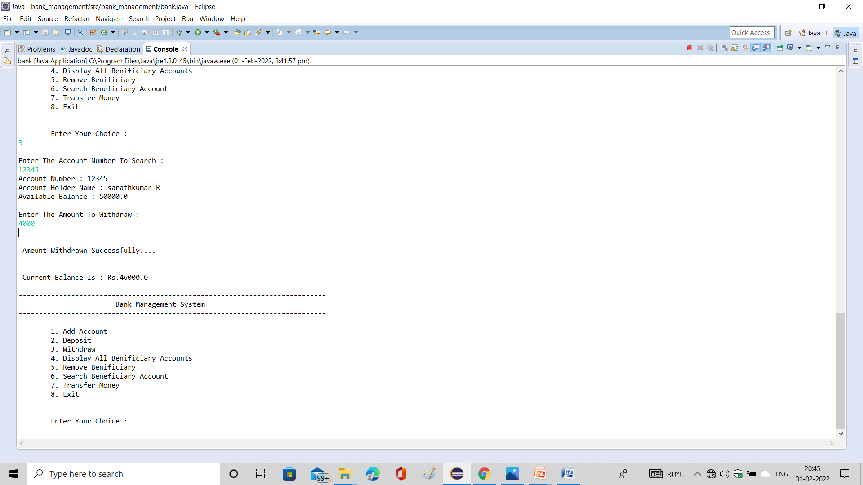

Slide 10
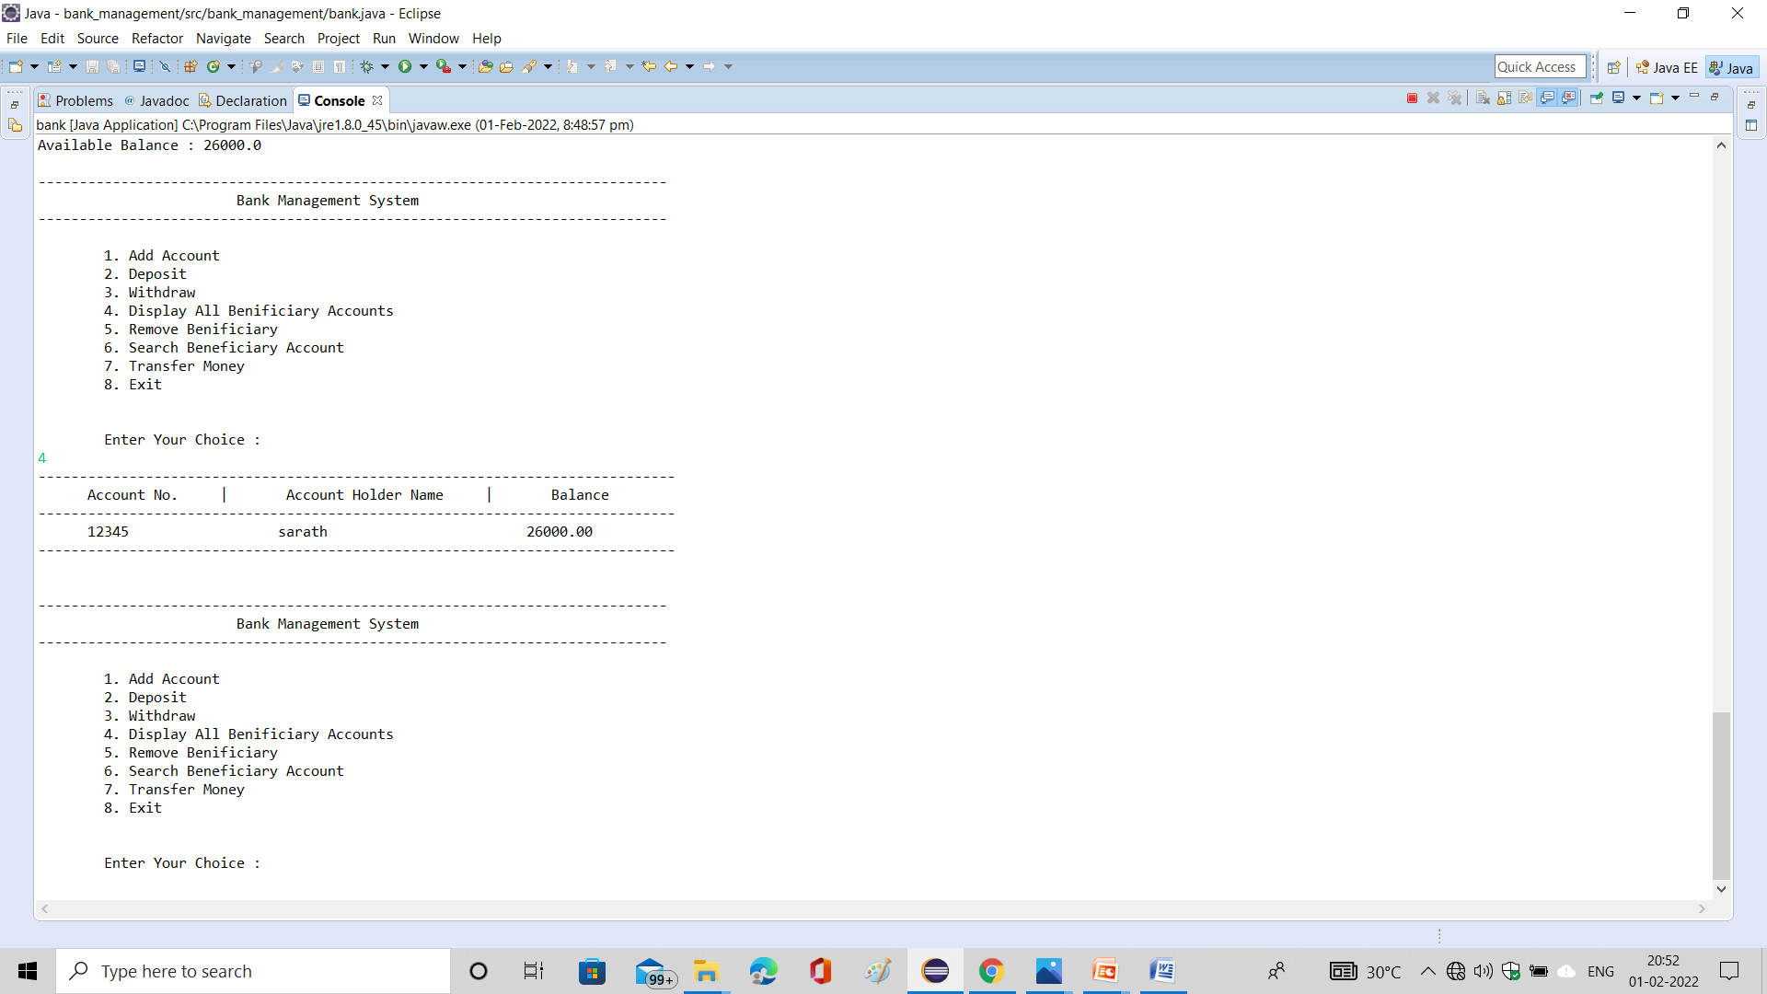

Slide 11
CONCLUSION
This Banking System will serve as useful approach to deposit and withdraw the money for the person.
It reduces the time taken by the user to user to save the money.
Bank system developed is user friendly.
It reduces manual work.

Slide 12
THANK YOU.

